Slide 1
Heart Disease : Maximum Heart Rate

Slide 2
Table of contents
01
02
03
04
05
06
07
Hypothesis, Variables, and Original Model
Interaction
Diagnostic plot
Log and Square transformation
Model Selection: Forward Selection
Model Interpretation
Conclusion

Slide 3
01
Hypothesis, Variables & Original Model

Slide 4
Question of Interest:
What characteristics can be used to predict the maximum heart rate of an individual?

Slide 5
Independent Variable
Response Variable
Age
Sex
chest_pain_type
resting_blood_pressure
(in mm Hg on admission to hospital)
serum_chol (mg/dl)
fasting_blood_sugar (120 mg/dl)
rest_ecg_result
excercise_induc
ST_depression (exercise vs rest)
slope (peak exercise ST segment)
major_vessels_fluoroscopy
thalassemia_type
heart_disease
max_heart _rate

Slide 6
Original Model:
max_heart_rate ~ age + sex + chest_pain_type + resting_blood_pressure + serum_chol + fasting_blood_sugar + rest_ecg_result + exercise_induc + ST_depression + slope + major_vessels_fluoroscopy + thalassemia_type
Estimate Std. Error t value Pr(>|t|)
(Intercept) 162.40203 6.41959 25.298 < 2e-16 ***
age -0.86608 0.06986 -12.398 < 2e-16 ***
sex -0.87214 1.32862 -0.656 0.51170
chest_pain_type 3.27620 0.61999 5.284 1.55e-07 ***
resting_blood_pressure 0.11292 0.03493 3.233 0.00126 **
serum_chol 0.03129 0.01177 2.659 0.00796 **
fasting_blood_sugar 2.38827 1.66467 1.435 0.15169
rest_ecg_result -0.92626 1.11177 -0.833 0.40496
exercise_induc -10.64962 1.39415 -7.639 5.07e-14 ***
ST_depression -1.22054 0.63182 -1.932 0.05366 .
slope 8.84287 1.14754 7.706 3.09e-14 ***
major_vessels_fluoroscopy -1.29139 0.60261 -2.143 0.03235 *
thalassemia_type 1.10418 0.97728 1.130 0.25881
---
Signif. codes: 0 ‘***’ 0.001 ‘**’ 0.01 ‘*’ 0.05 ‘.’ 0.1 ‘ ’ 1
Residual standard error: 18.21 on 1012 degrees of freedom
Multiple R-squared: 0.3809, Adjusted R-squared: 0.3735
F-statistic: 51.88 on 12 and 1012 DF, p-value: < 2.2e-16
Residuals:
Min 1Q Median 3Q Max
-62.373 -10.746 2.838 11.658 45.853
Coefficients:

Slide 7
02
Interactions

Slide 8
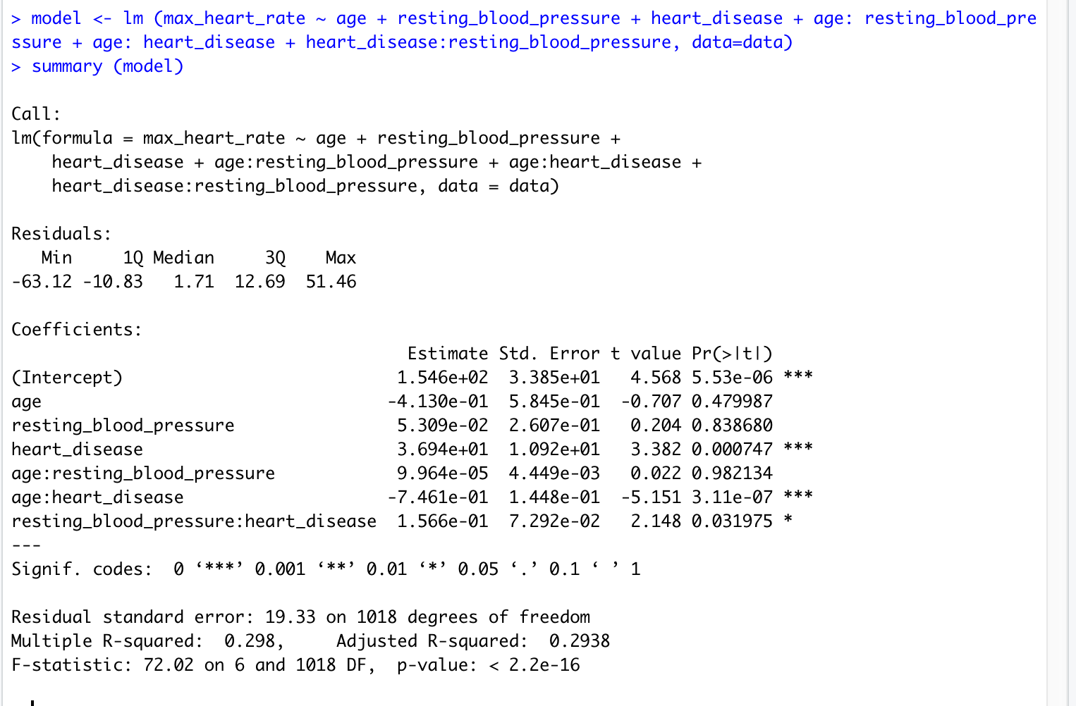
Interaction
(Indicator Variables & Continuous Variables)
Statistically Significant
heart_disease, heart_disease:age, heart_disease:Resting_blood_pressure
Non Statistically Significant
Age, Resting blood pressure
Model Fit
Residual Standard error: 19.33
Multiple R-squared: 0.298
Adjusted R-squared: 0.2938 (slightly slower)
F-statistic: 72.02 on 6 and 1018 degrees of freedom
P-value < 2.2e-16

Slide 9
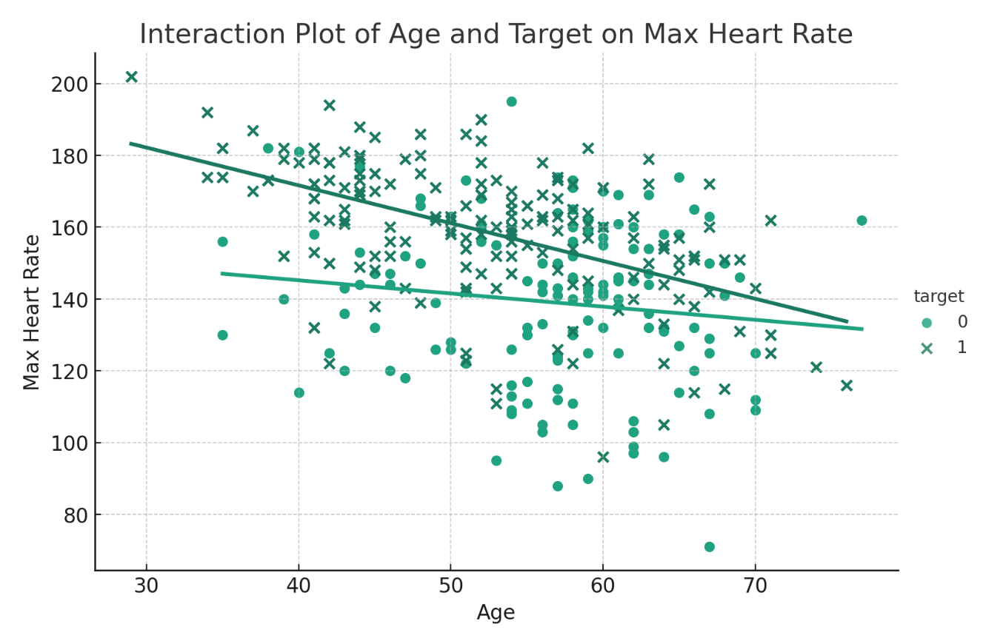
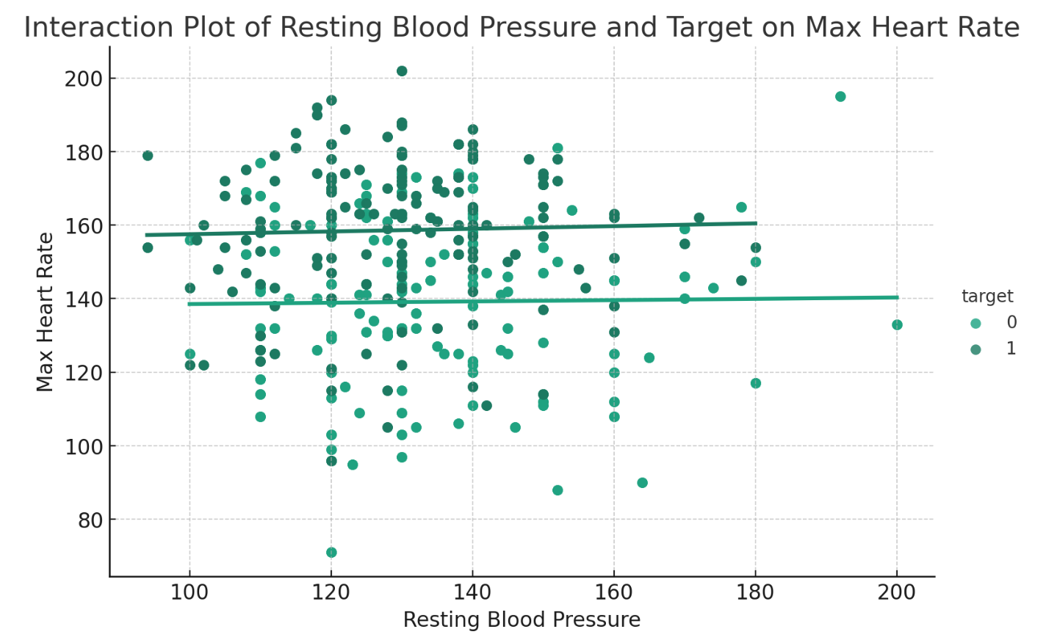
Visualizing Relationship
Age:heart_disease Interaction
Resting_blood_pressure:heart_disease Interaction
Age:Resting blood pressure interaction is non-significant, we remove the interaction.

Slide 10
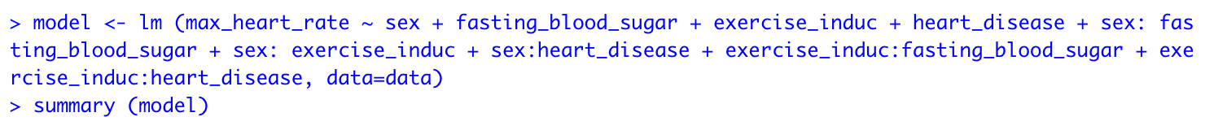
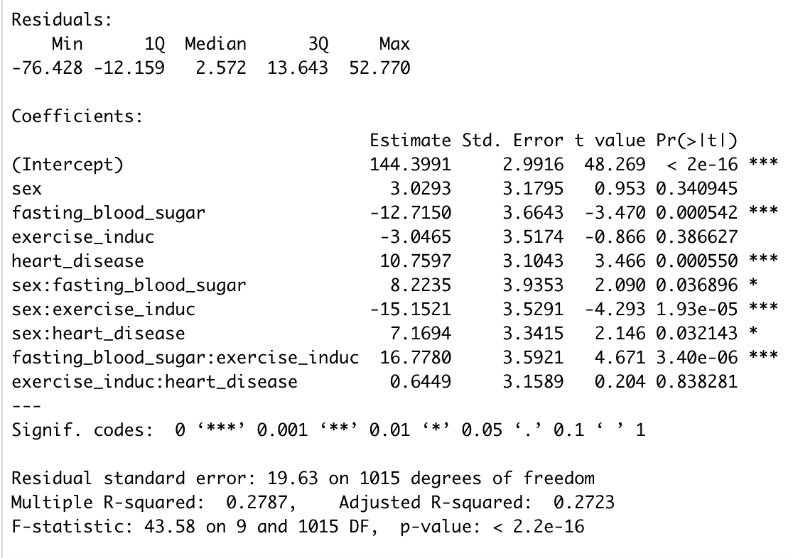
Interaction
(Indicator Variables & Indicator Variables)
Statistically Significant
sex:exercise_induc, sex:heart_disease, and fasting_blood_sugar:exercise_induc, fasting_blood_sugar, sex:fasting_blood_sugar and intercept
Not Statistically Significant
Sex, exercise_induc, heart_disease, fasting_blood_sugar:heart_disease, exercise_induc:heart_disease
Model Fit
Residual Standard error: 19.63
Multiple R-squared: 0.2788
Adjusted R-squared: 0.2716 (slightly slower)
F-statistic: 39.19 on 10 and 1014 degrees of freedom
P-value < 2.2e-16

Slide 11
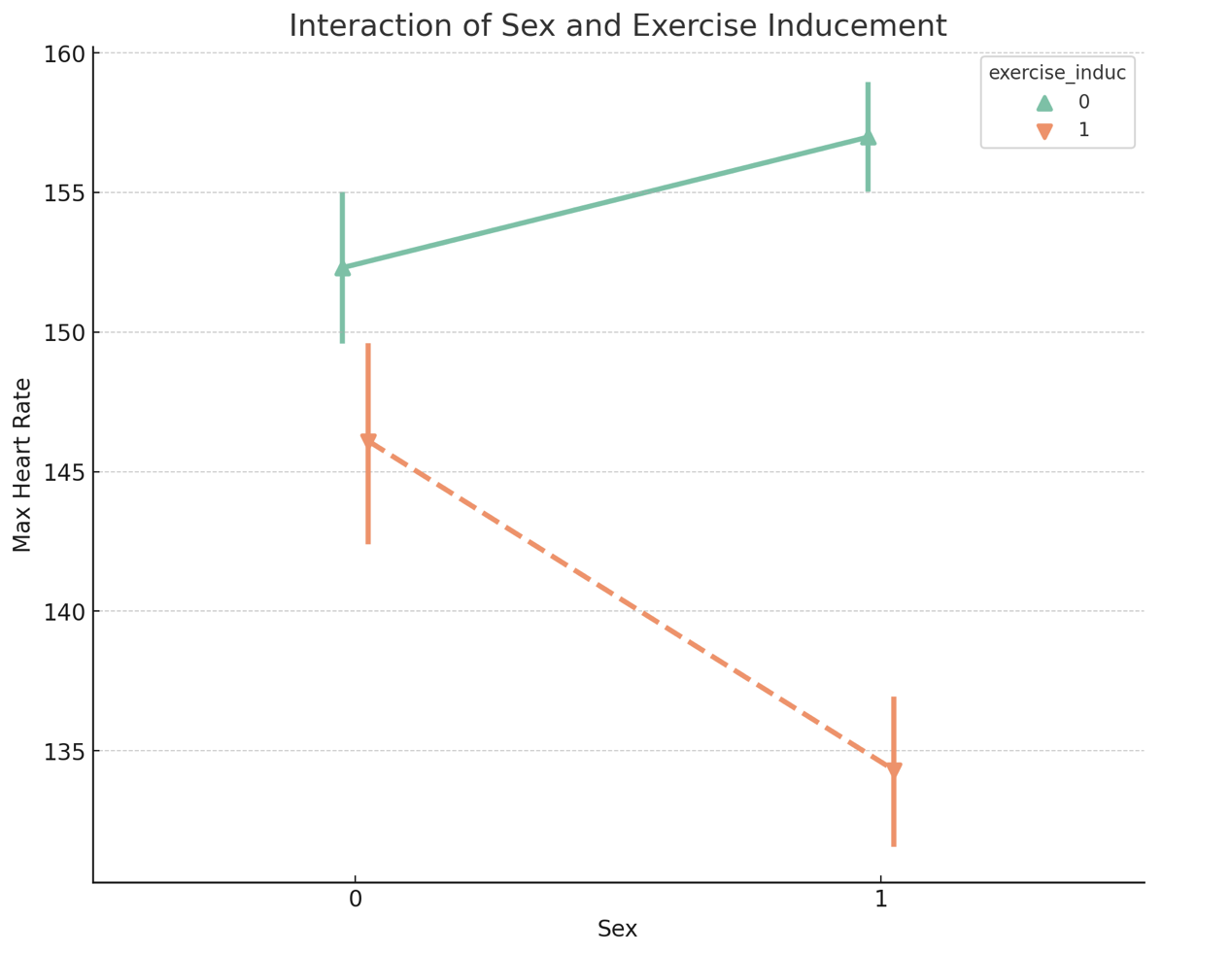
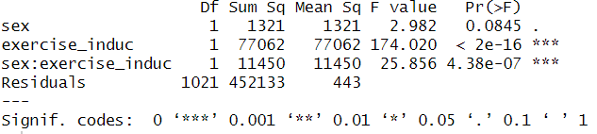
Visualizing relationship between sex
and exercise inducement
ANOVA analysis

Slide 12
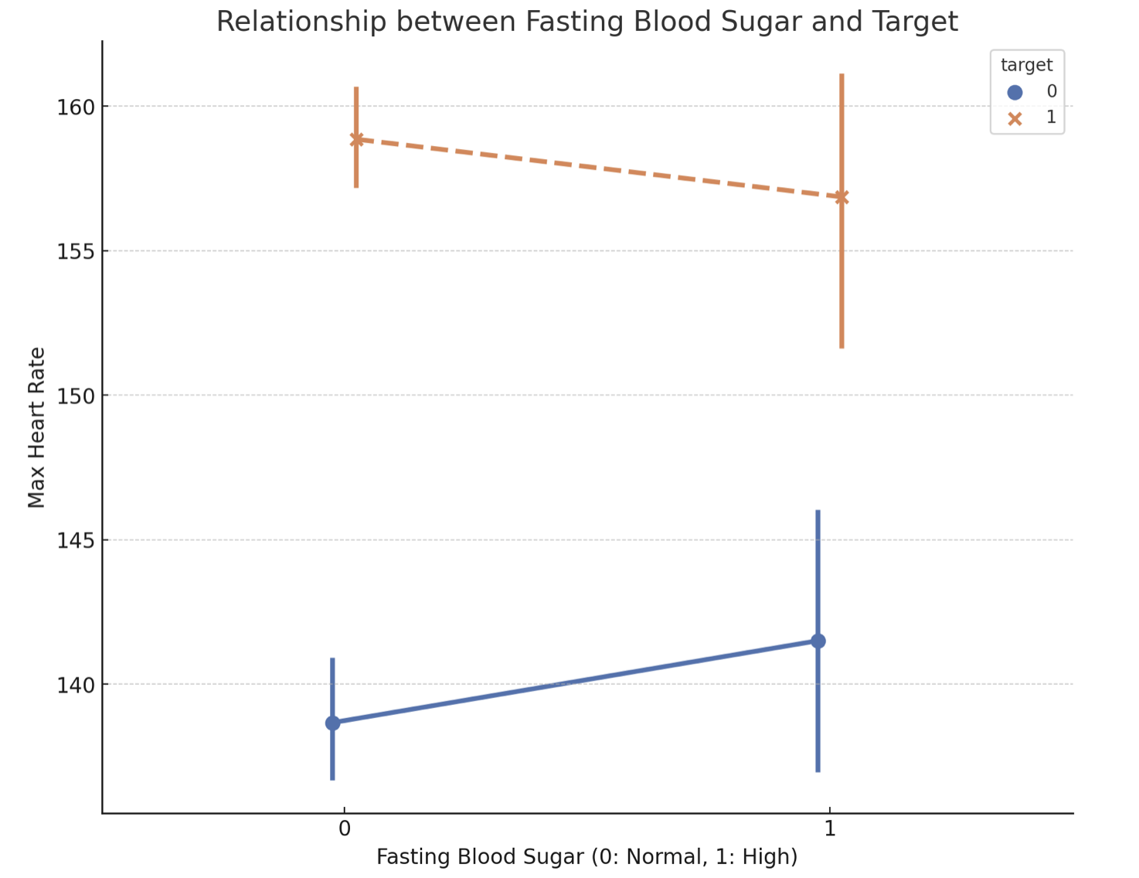
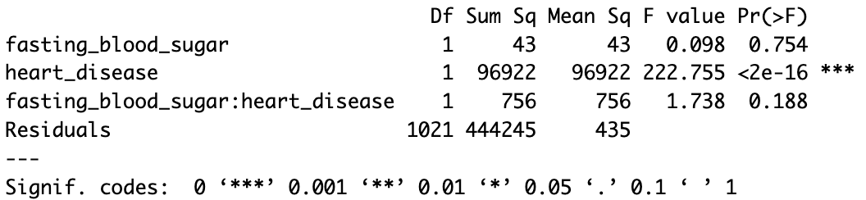
Visualizing relationship between
Fasting Blood Sugar and heart_disease
ANOVA analysis

Slide 13
03
Diagnostic Plots

Slide 14
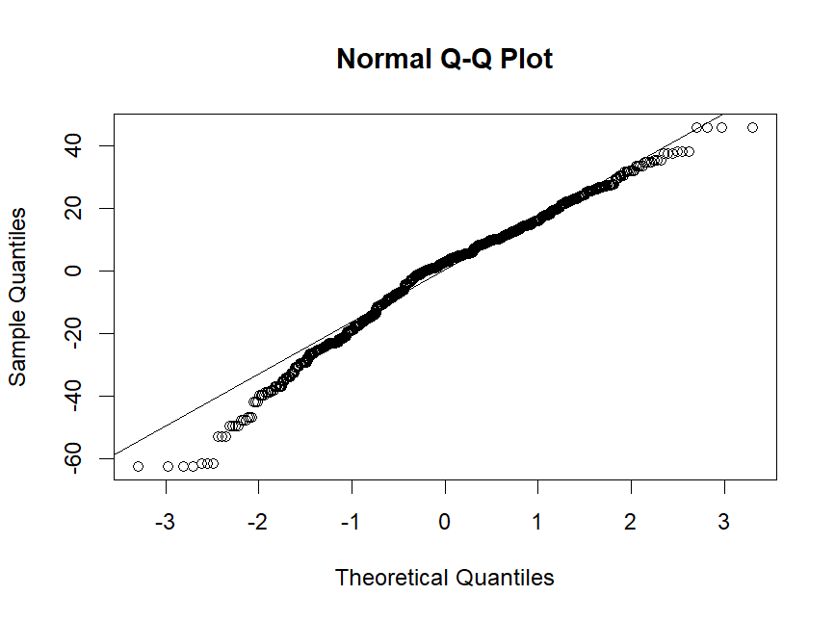
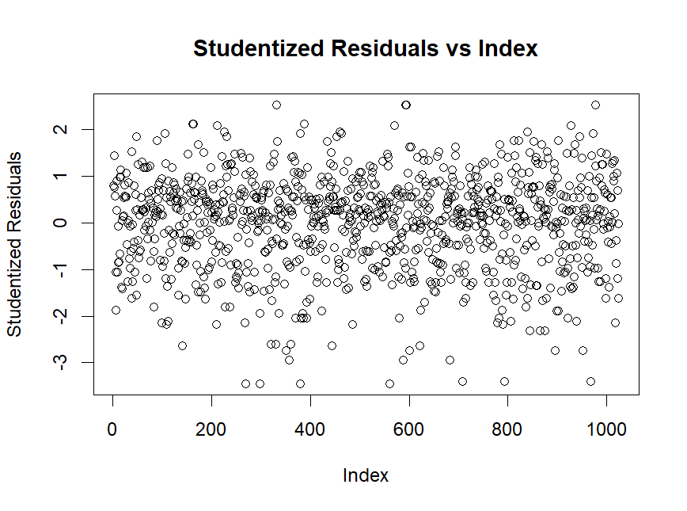
Diagnostic Plots

Slide 15
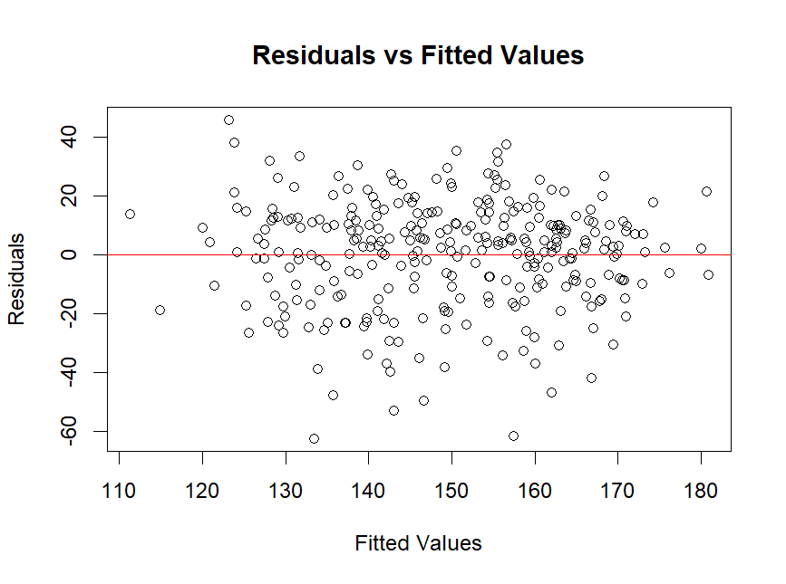
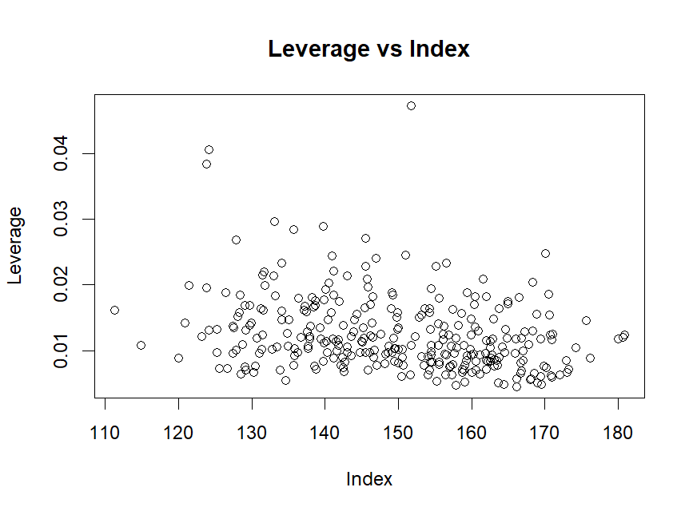
Diagnostic Plots

Slide 16
04 Model 2:
Log Transformation & Box-cox Transformation
(All Variables)

Slide 17
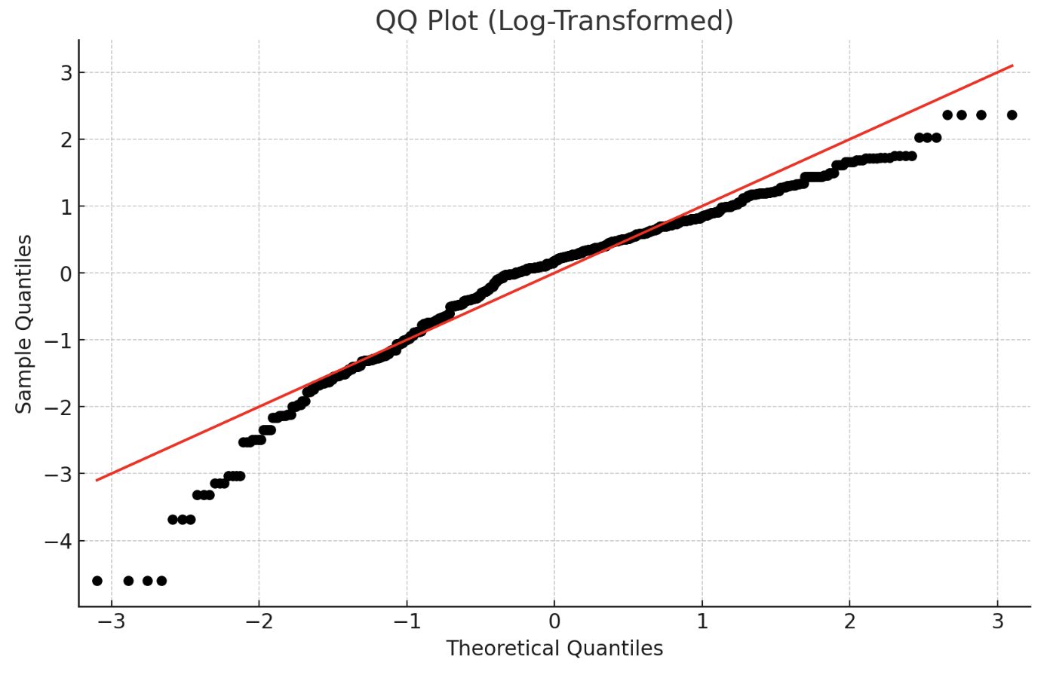
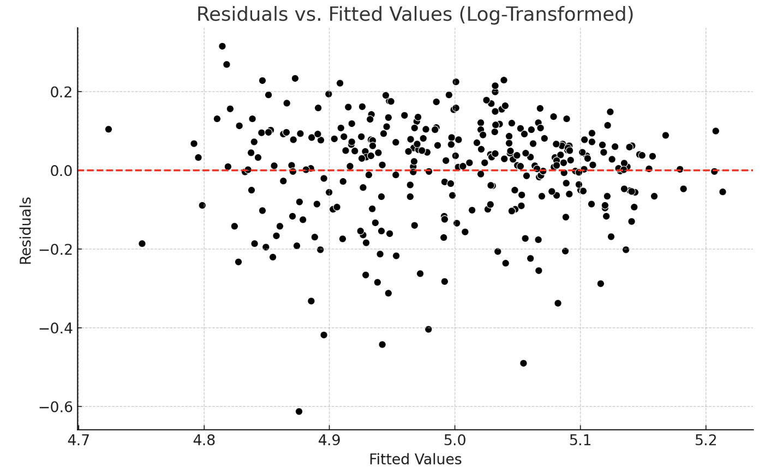
Log transformation (All variables)

Slide 18
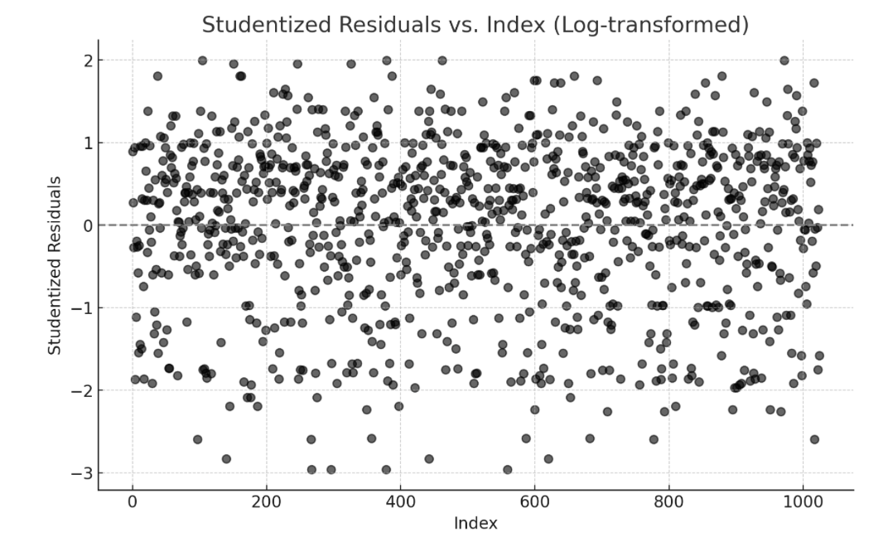
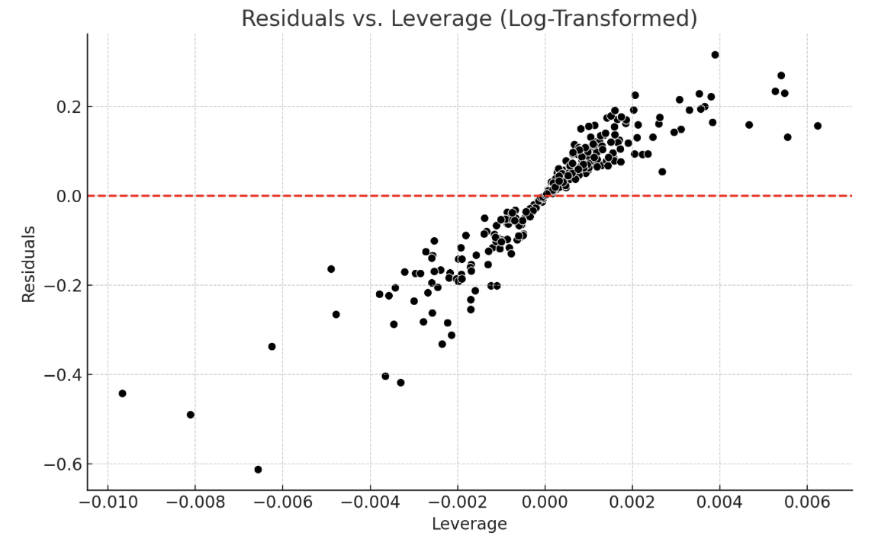
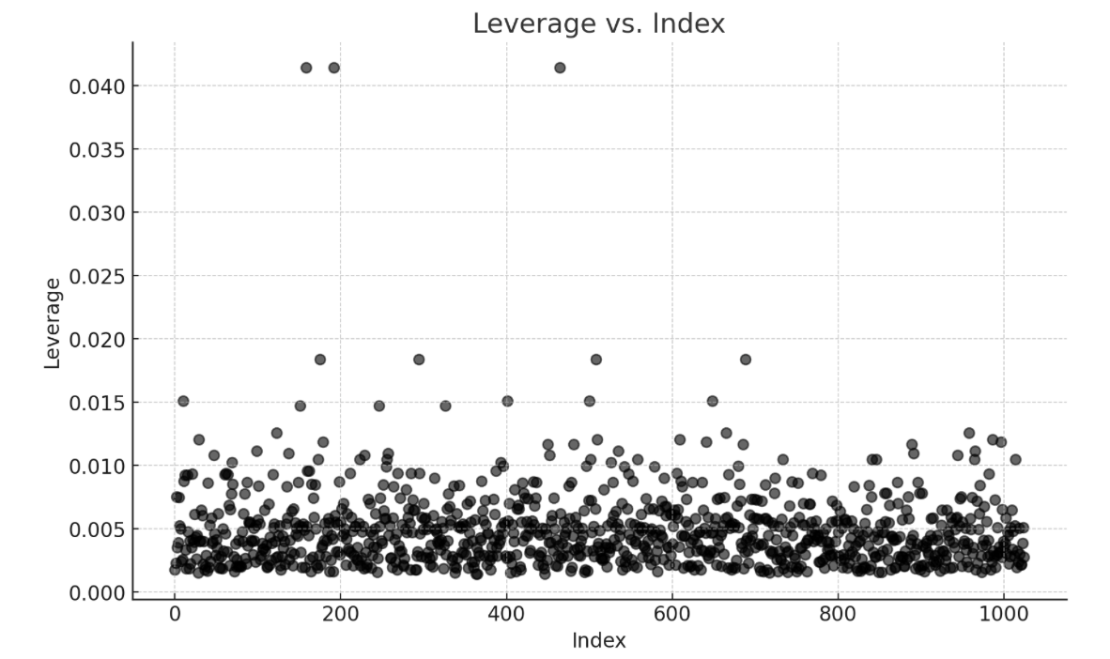
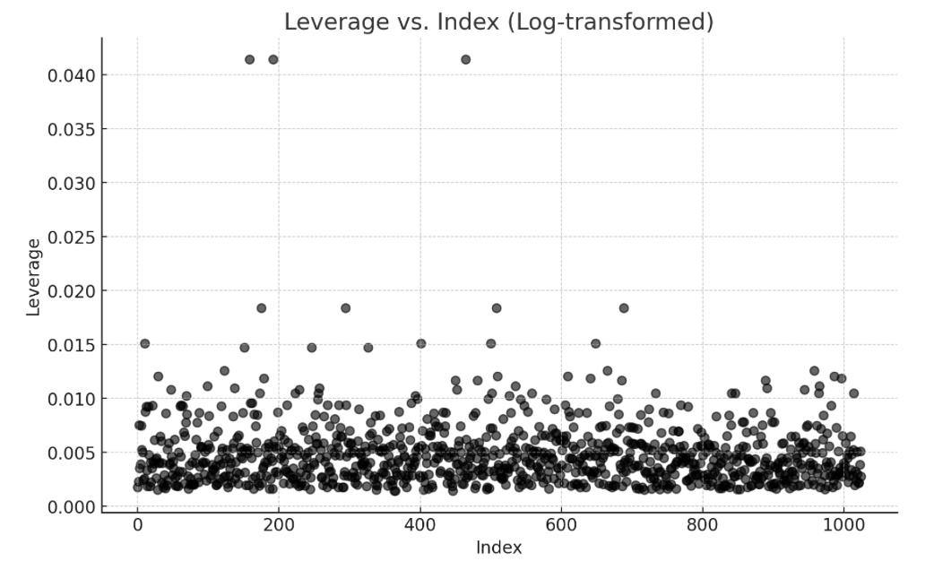
Log transformation (All variables)

Slide 19
What is a Box-cox Transformation?
A transformation of non-normal dependent variables into a normal shape
Normality : important assumption for many statistical techniques
If your data isn't normal, applying a Box-Cox means that you are able to run a broader number of tests.
R : use the command boxcox(object, …).

Slide 20
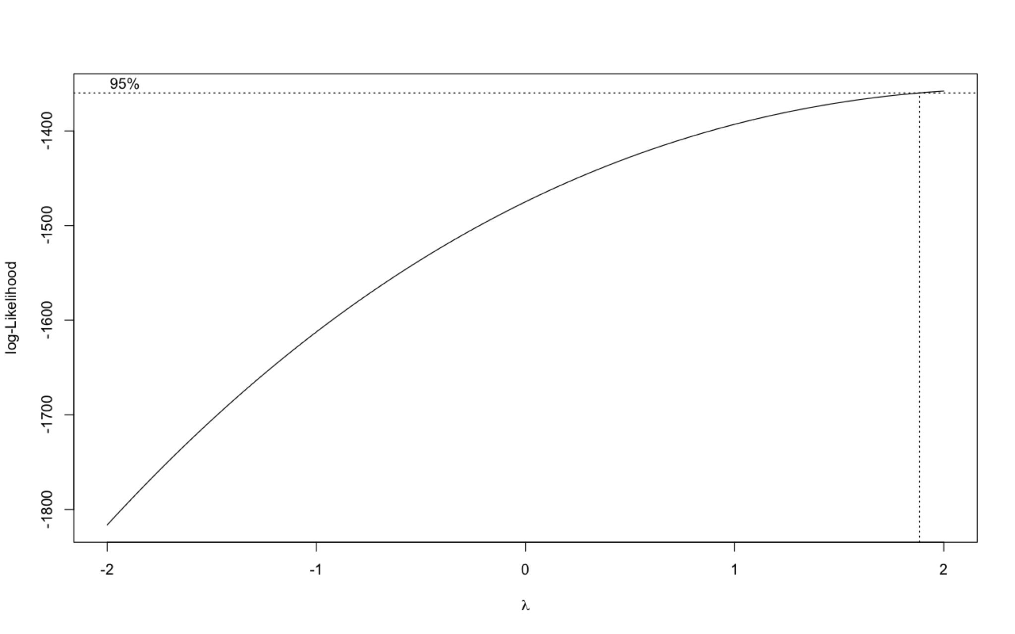
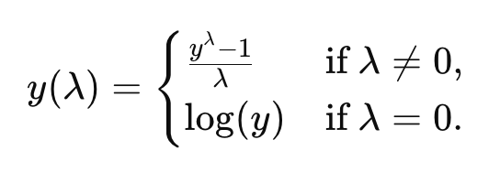
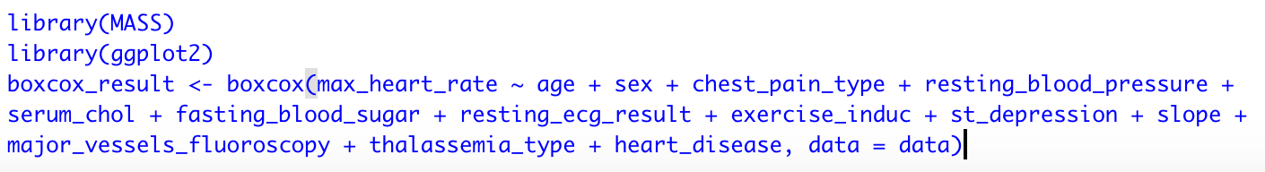
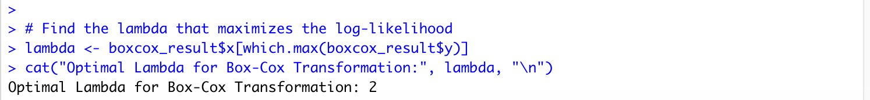
Our case -
Family of power Transformation

Slide 21
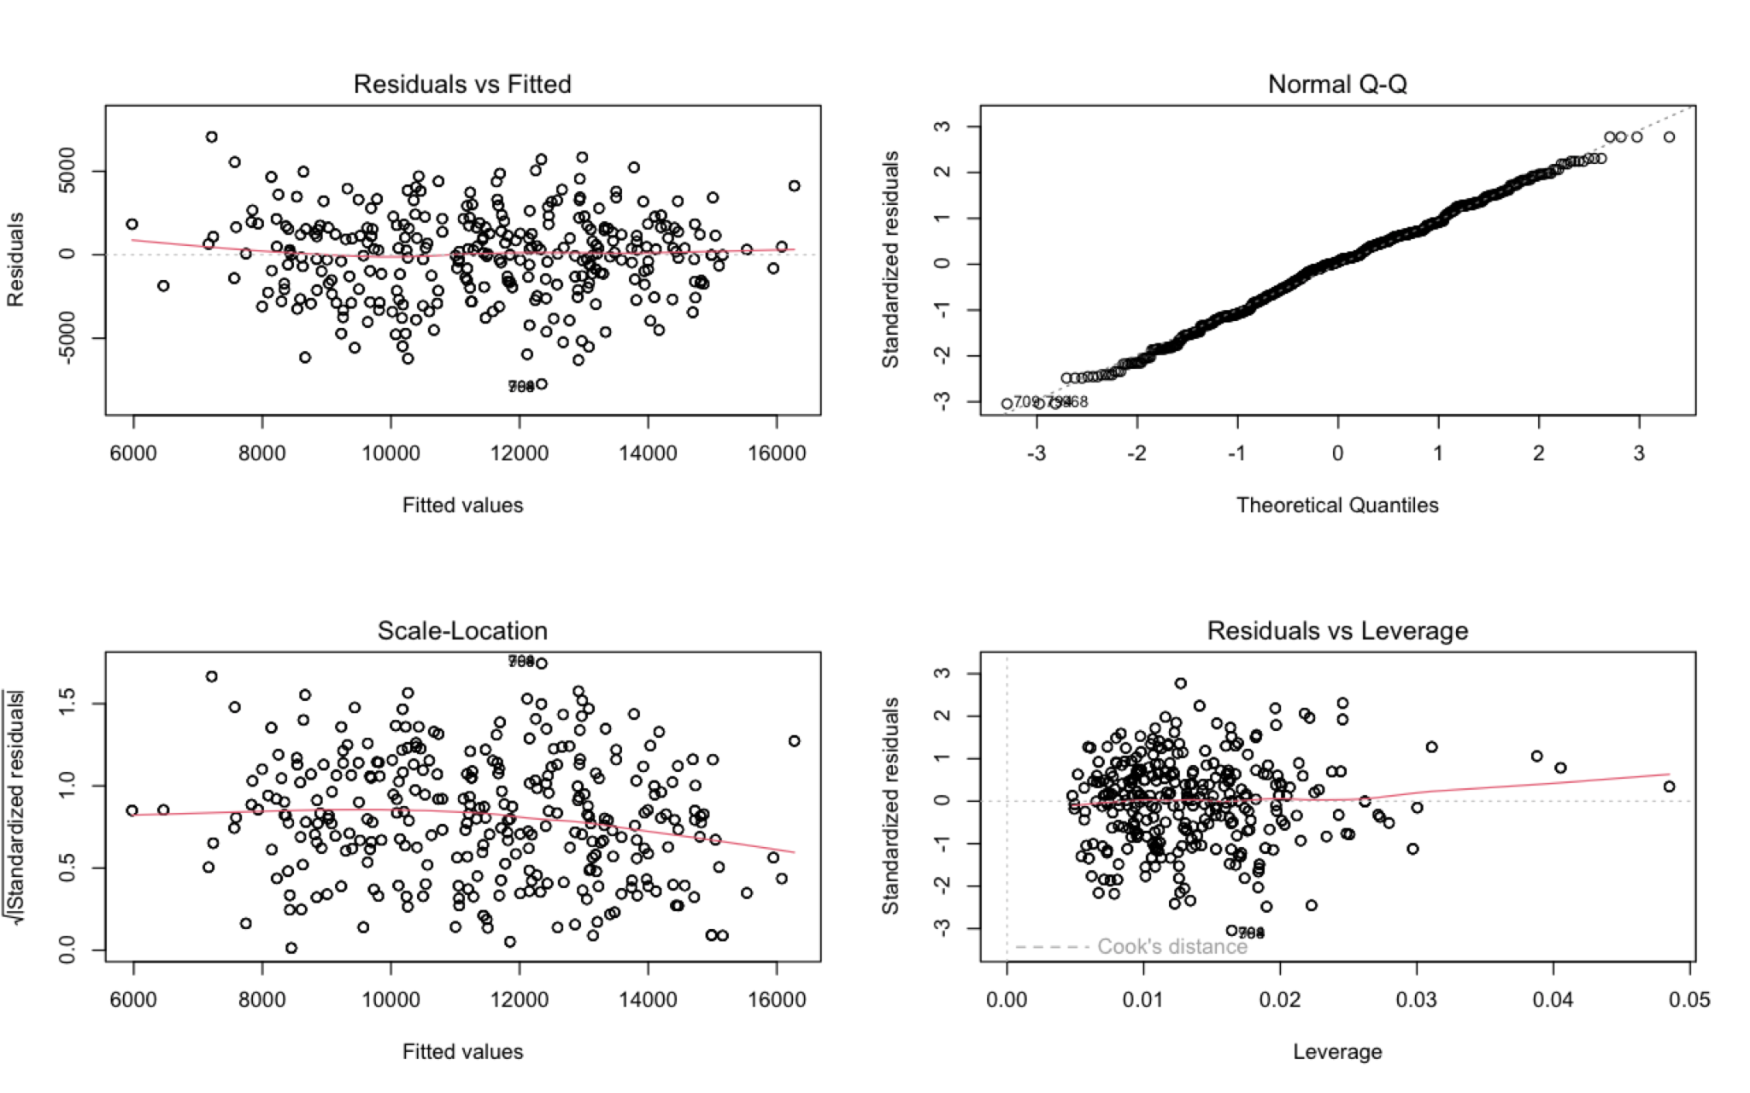
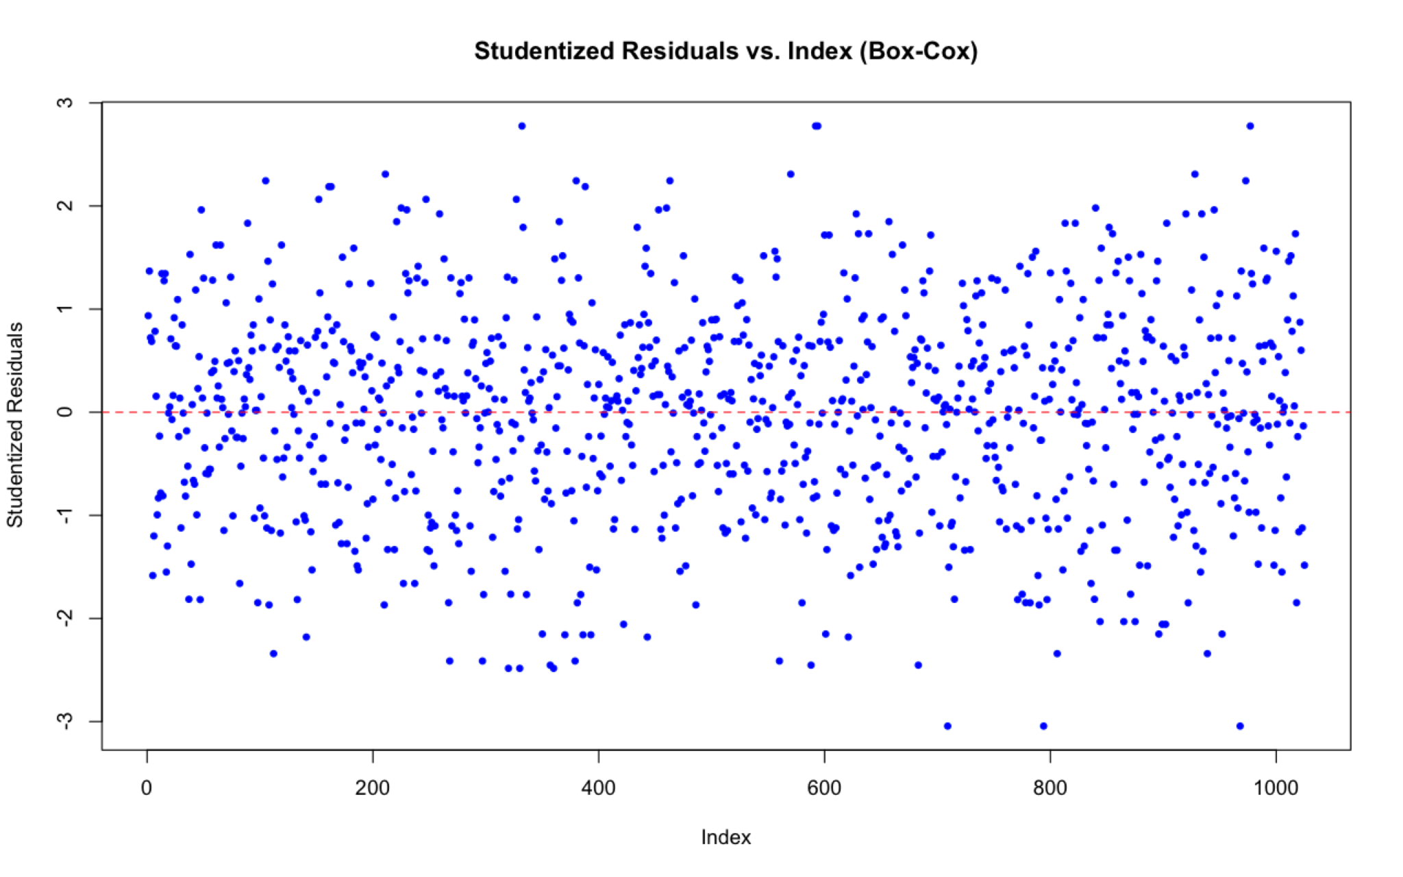
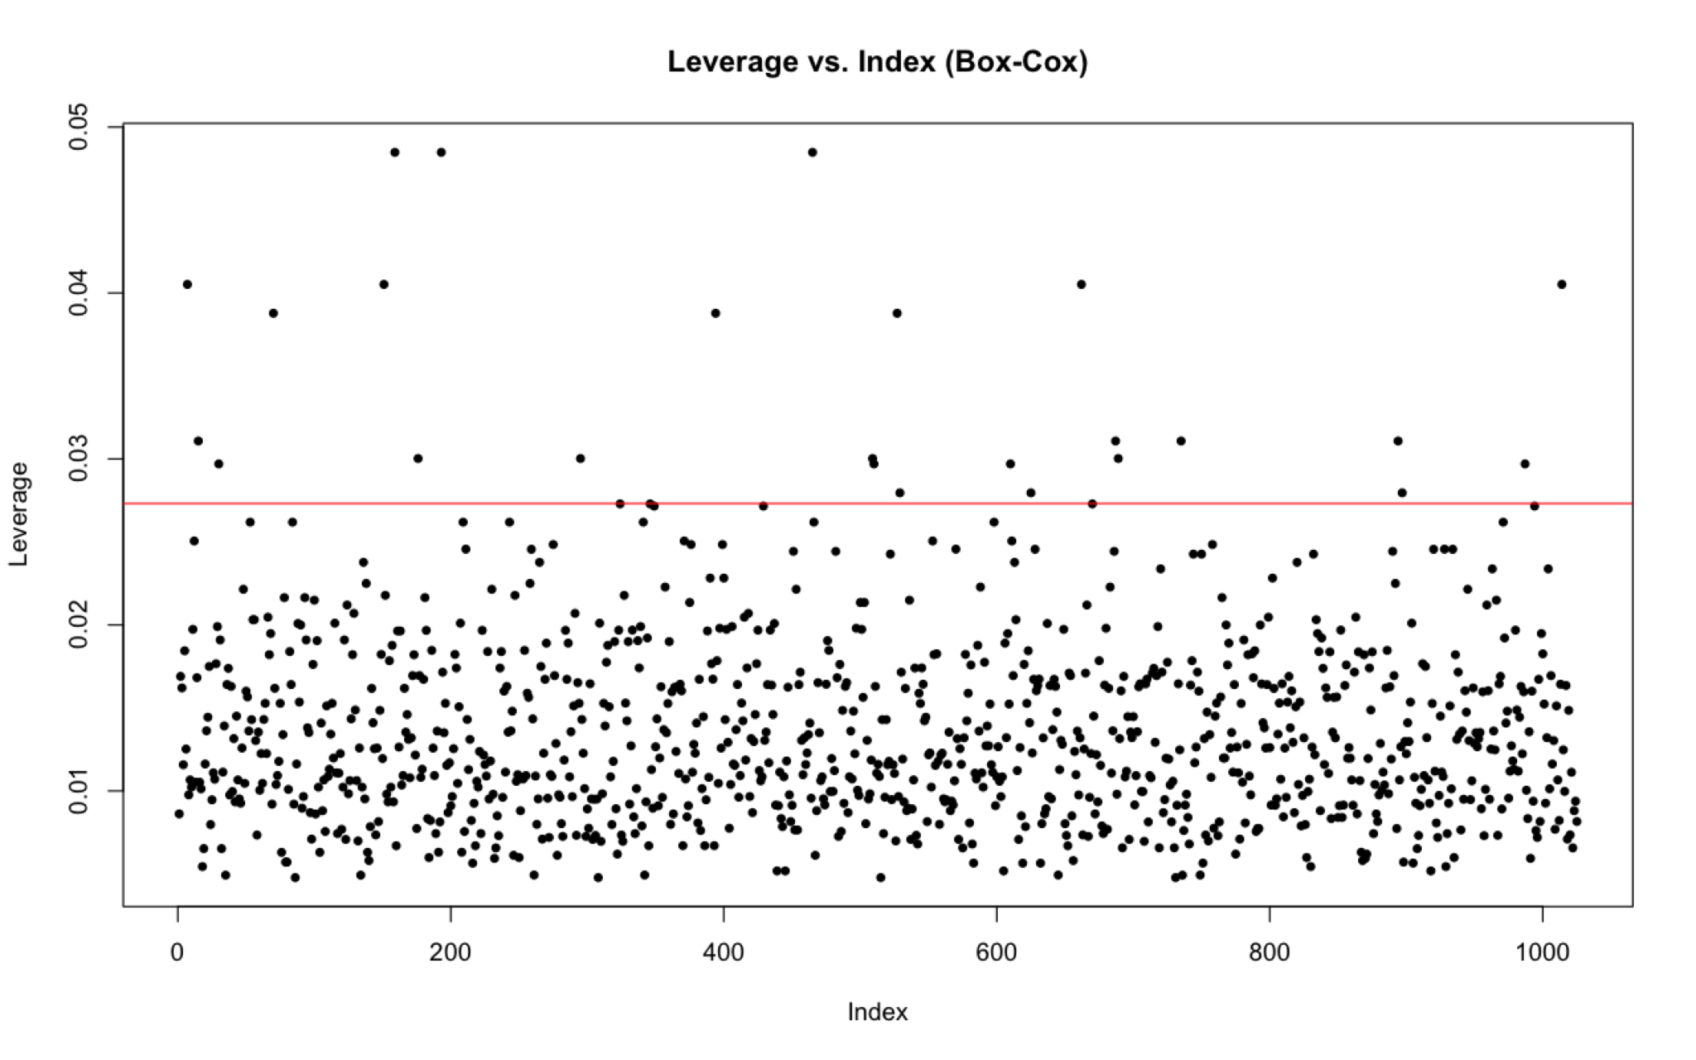
Outliers and Leverage in
Square Transformation (All variables)

Slide 22
Outliers for studentized Residuals vs index plot
2.5
Key
findings
-2.5

Slide 23
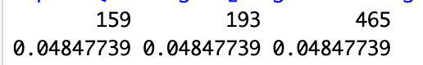
Highest Leverages for Leverage vs. index plot
Key findings
<- Three observations with the
highest leverage (159, 193, 465)

Slide 24
04: Model 3
Box-cox Transformation (Selected Variables)
age, chest_pain_type, resting_blood_pressure, serum_chol, exercise_induc, slope, thalassemia_type, heart_disease

Slide 25
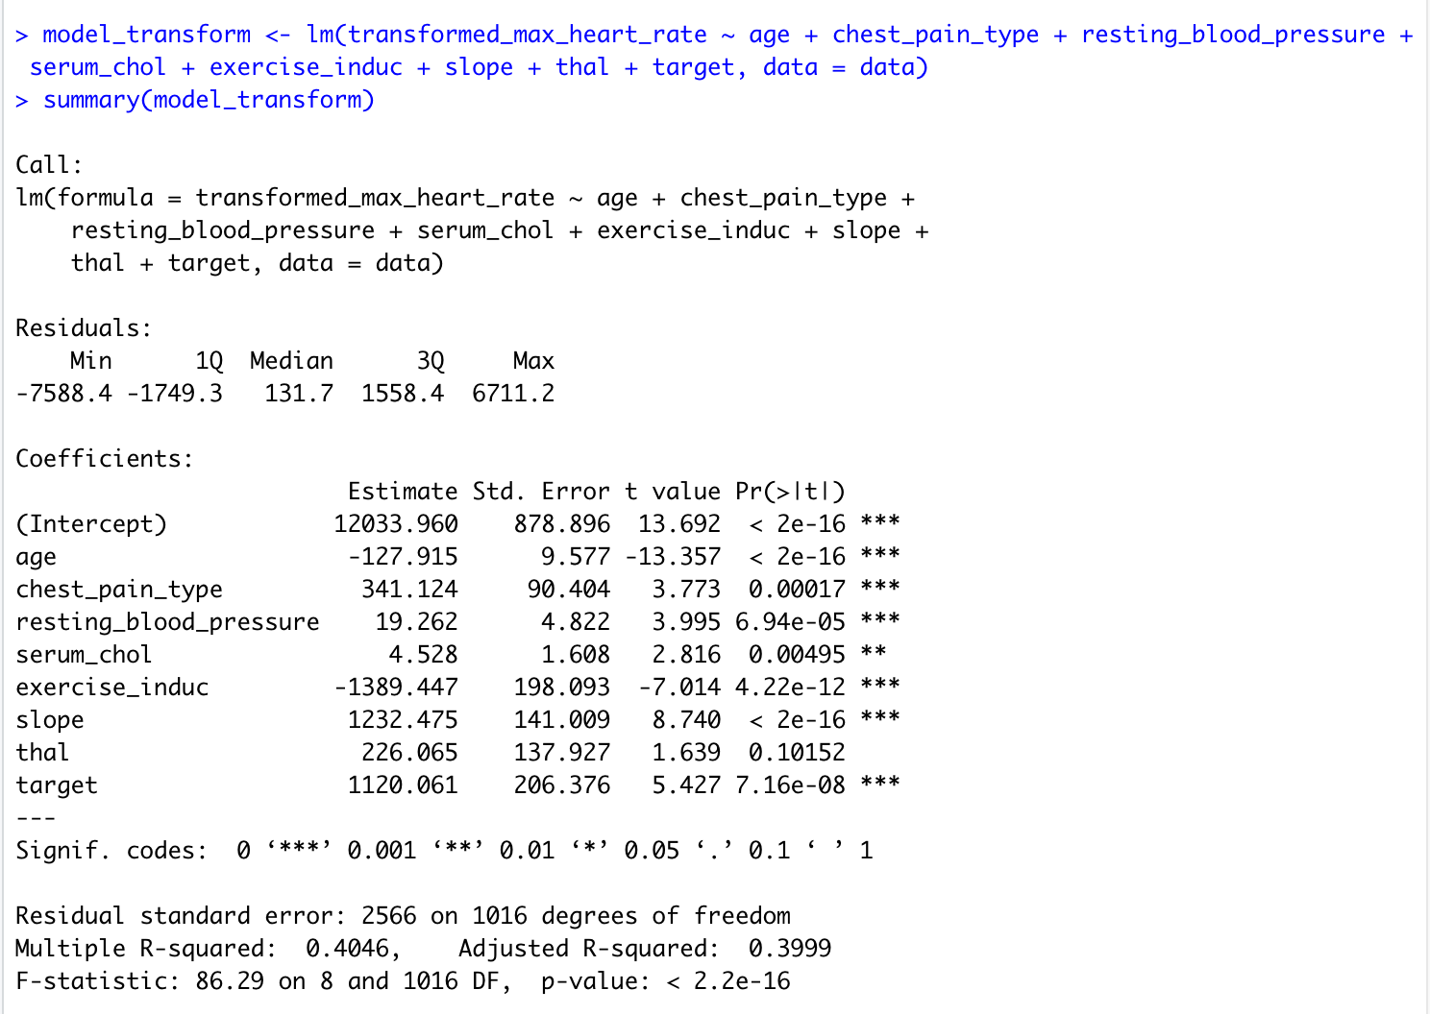
The Output
Estimate
P-value:
“Thal” is not statistically significant.
R-squared = 0.4046
40.46% of the variance in list prices represent good fit.

Slide 26
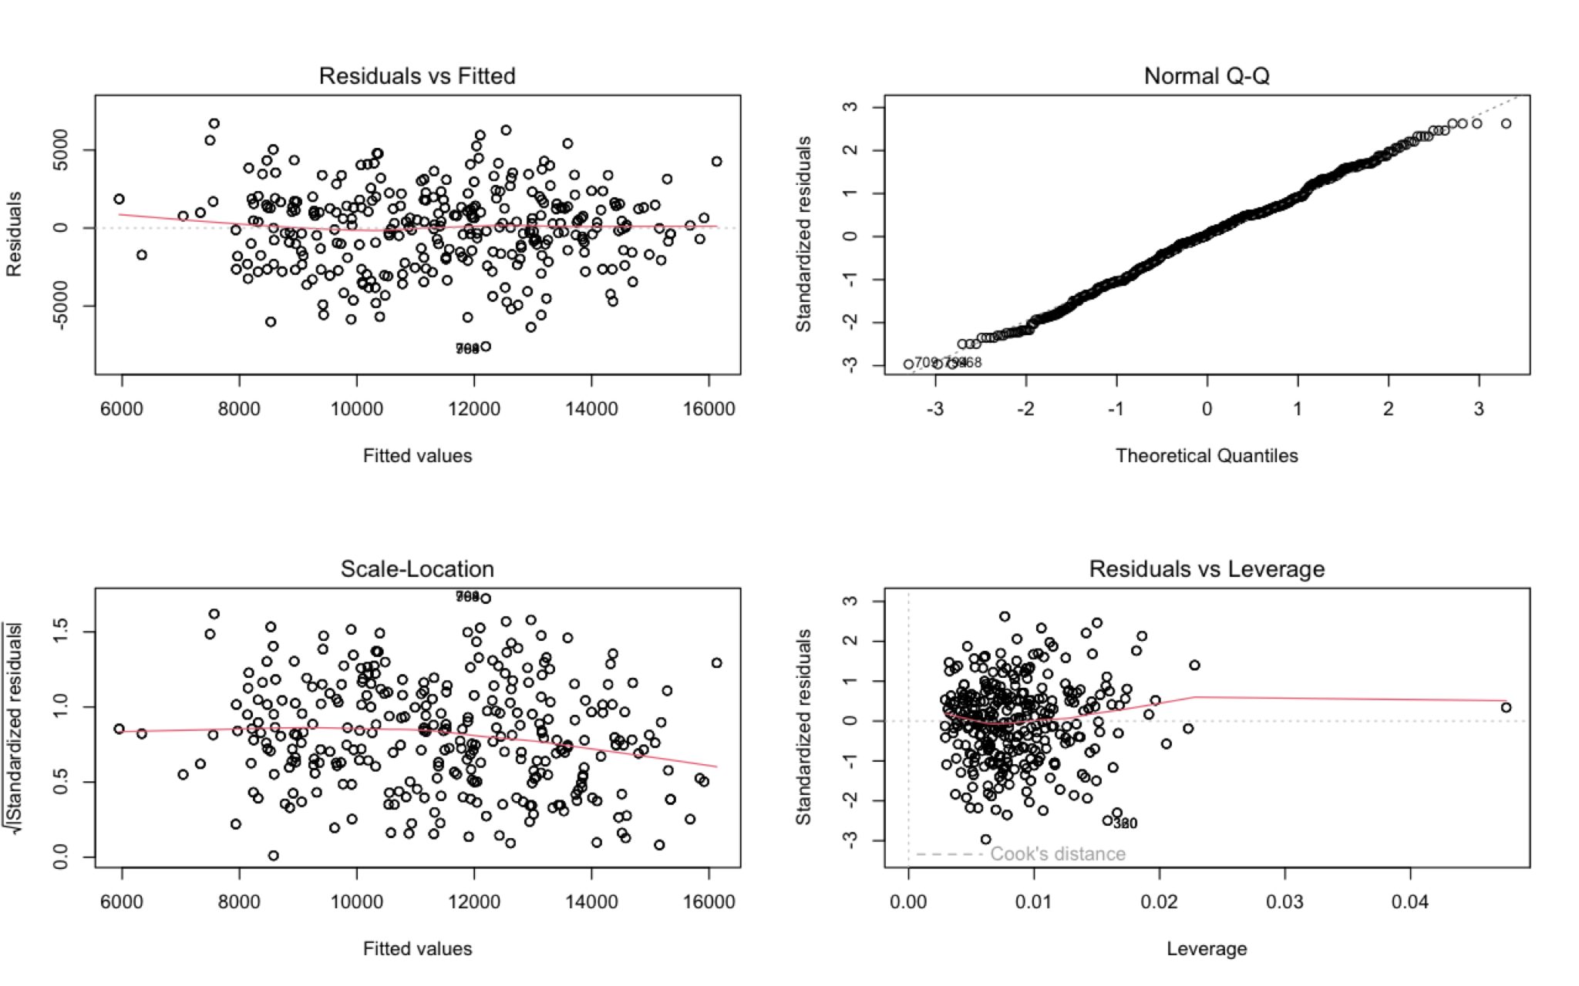
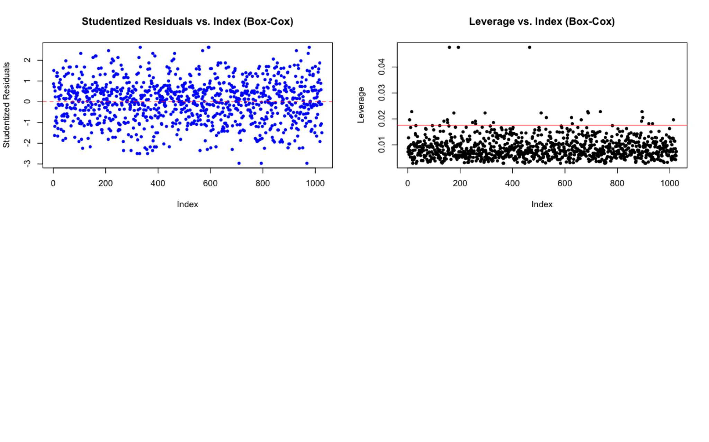
Diagnostic Plots

Slide 27
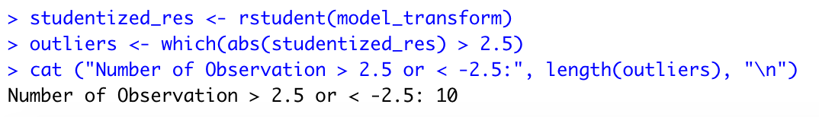
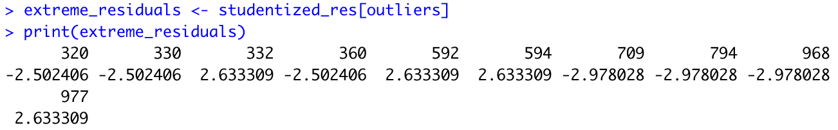
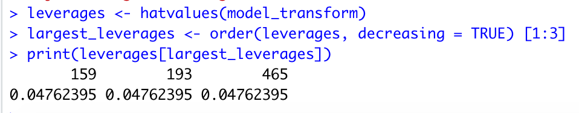
Outliers & Highest Leverage
Key findings
Points with studentized residuals >2.5 or <-2.5:
10 outliers
3 highest leverage points:
Index: 159, 193, 465

Slide 28
05: Model
Selection:
Forward Selection

Slide 29
Forward Selection:
max_heart_rate ~ 1, AIC = 6429.27
1
7
2
8
3
4
9
5
6
max_heart _rate ~ heart_disease, AIC = 6229.31
max_heart _rate ~ heart_disease + age + slope + exercise_induc + resting_blood_pressure + chest_pain_type + serum_chol, AIC = 5939
max_heart _rate ~ heart_disease + age, AIC = 6111.24
max_heart _rate ~ heart_disease + age + slope + exercise_induc + resting_blood_pressure + chest_pain_type + serum_chol + thalassemia_type, AIC = 5937.58
max_heart _rate ~ heart_disease + age + slope, AIC = 6031.19
max_heart _rate ~ heart_disease + age + slope + exercise_induc, AIC = 5976.78
max_heart _rate ~ heart_disease + age + slope + exercise_induc + resting_blood_pressure + chest_pain_type + serum_chol + thalassemia_type + fasting_blood_sugar AIC = 5937.31
max_heart _rate ~ heart_disease + age + slope + exercise_induc + resting_blood_pressure, AIC = 5959.13
max_heart _rate ~ heart_disease + age + slope + exercise_induc + resting_blood_pressure + chest_pain_type, AIC = 5947

Slide 30
Final Model : max_heart _rate ~ heart_disease + age + slope + exercise_induc + resting_blood_pressure + chest_pain_type + serum_chol + thalassemia_type + fasting_blood_sugar
Removed from Original Model: rest_ecg_result + ST_depression + major_vessels_fluoroscopy

Slide 31
05: Model Interpretation

Slide 32
Summary of Forward Selection
Call:
lm(formula = max_heart_rate ~ heart_disease + age + slope + exercise_induc + resting_blood_pressure + chest_pain_type + serum_chol + thalassemia_type + fasting_blood_sugar, data = data)
Residuals:
Min 1Q Median 3Q Max
-60.989 -10.766 1.935 11.345 46.128
Coefficients:
Estimate Std. Error t value Pr(>|t|)
(Intercept) 151.31213 6.19751 24.415 < 2e-16 ***
heart_disease 7.99722 1.44990 5.516 4.41e-08 ***
age -0.85330 0.06743 -12.656 < 2e-16 ***
slope 8.64635 0.99041 8.730 < 2e-16 ***
exercise_induc -9.33871 1.39380 -6.700 3.44e-11 ***
resting_blood_pressure 0.12085 0.03421 3.532 0.000431 ***
chest_pain_type 2.40077 0.63818 3.762 0.000178 ***
serum_chol 0.03421 0.01129 3.030 0.002509 **
thalassemia_type 1.87839 0.97053 1.935 0.053216 .
fasting_blood_sugar 2.43532 1.62423 1.499 0.134087
---
Signif. codes: 0 ‘***’ 0.001 ‘**’ 0.01 ‘*’ 0.05 ‘.’ 0.1 ‘ ’ 1
Residual standard error: 18.02 on 1015 degrees of freedom
Multiple R-squared: 0.392, Adjusted R-squared: 0.3866
F-statistic: 72.7 on 9 and 1015 DF, p-value: < 2.2e-16
Statistically Significant
Heart_disease, age, slope, exercise_induc, resting_blood_pressure, chest_pain_type, and serum_chol
Not Statistically Significant
thalsassemia_type and fast_blood_sugar
Model Fit
Residual Standard error: 18.02
Multiple R-squared: 0.392
Adjusted R-squared: 0.3866 (slightly slower)
F-statistic: 72.7 on 9 and 1015 degrees of freedom
P-value < 2.2e-16

Slide 33
07
Conclusion

Slide 34
Conclusion
Y-variable: Maximum Heart Rate
Original Regression & Interaction
Diagnostic Plots - normality and homoscedasticity problem
Log transformation - Not works well
Square transformation - meeting linear regression
Model selection - forward selection
Statistically significant variables:
Heart_disease, age, slope, exercise_induc, resting_blood_pressure, chest_pain_type, and serum_chol

Slide 35
Thank You!

